Slide 1
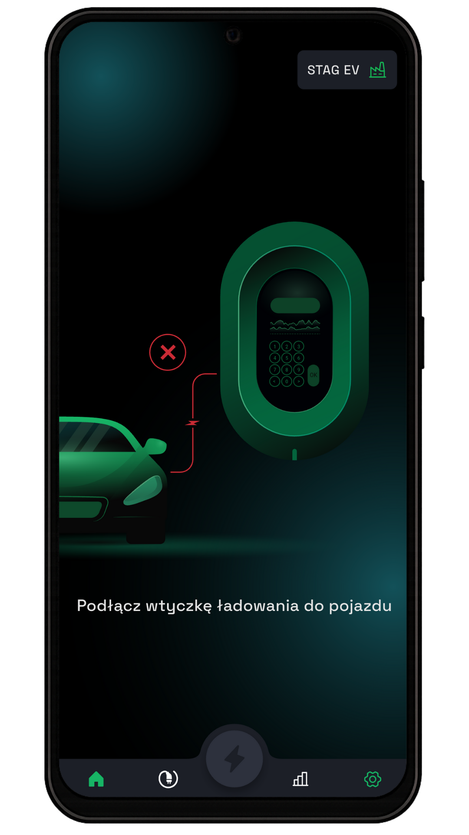
User Manual
for STAGEV app

Slide 2
Table of Contents
1. Registration 3
1.1 Creating an Account and Logging In 3
1.2 Adding a charger 4
1.3 Adding Additional Chargers 5
Main viev 5
2.1 Description of the Main View 6
2.2 Charging modes 7
2.3 Charger Location 8
2.4 Pausing and Resuming Charging 9
2.5 Ending the Charging Session 9
Settings 10
3.1 Personal Information 11
3.2 Notifications 11
3.3 Adding a Second Account 12
3.4 Managing Access to STAGEV 13
3.5 Setting Charging Modes 13
3.6 Connection Power Limit 14
Statistics 14
4.1 Charging History 15

Slide 3

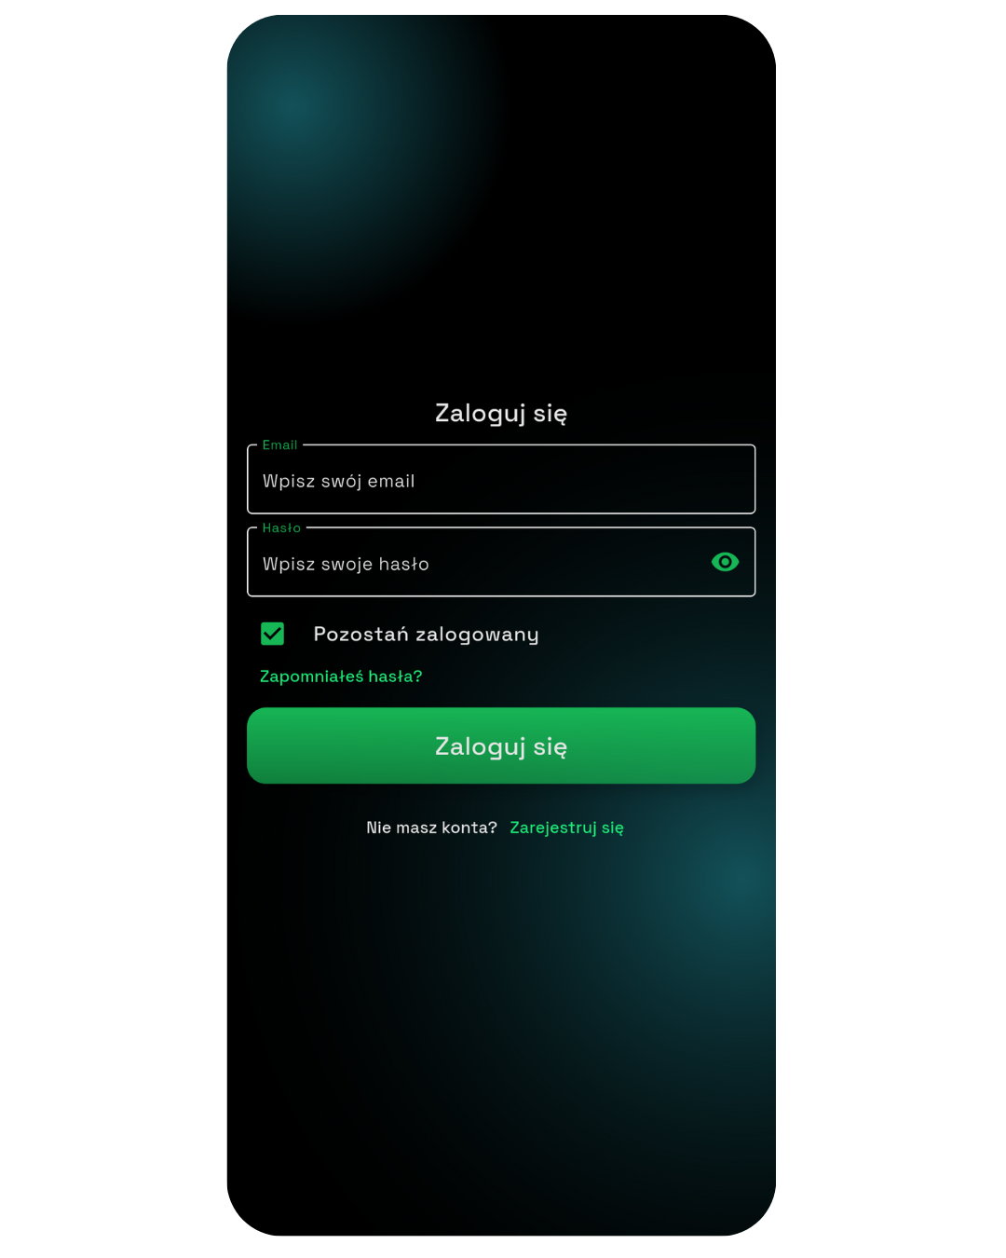
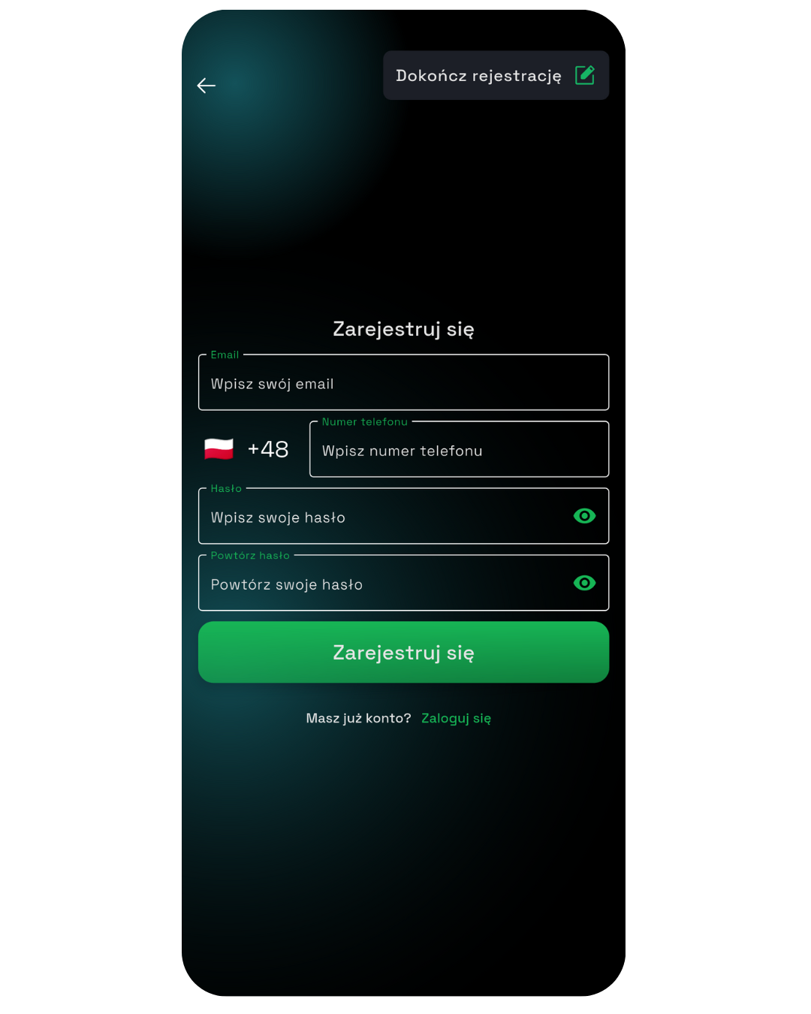
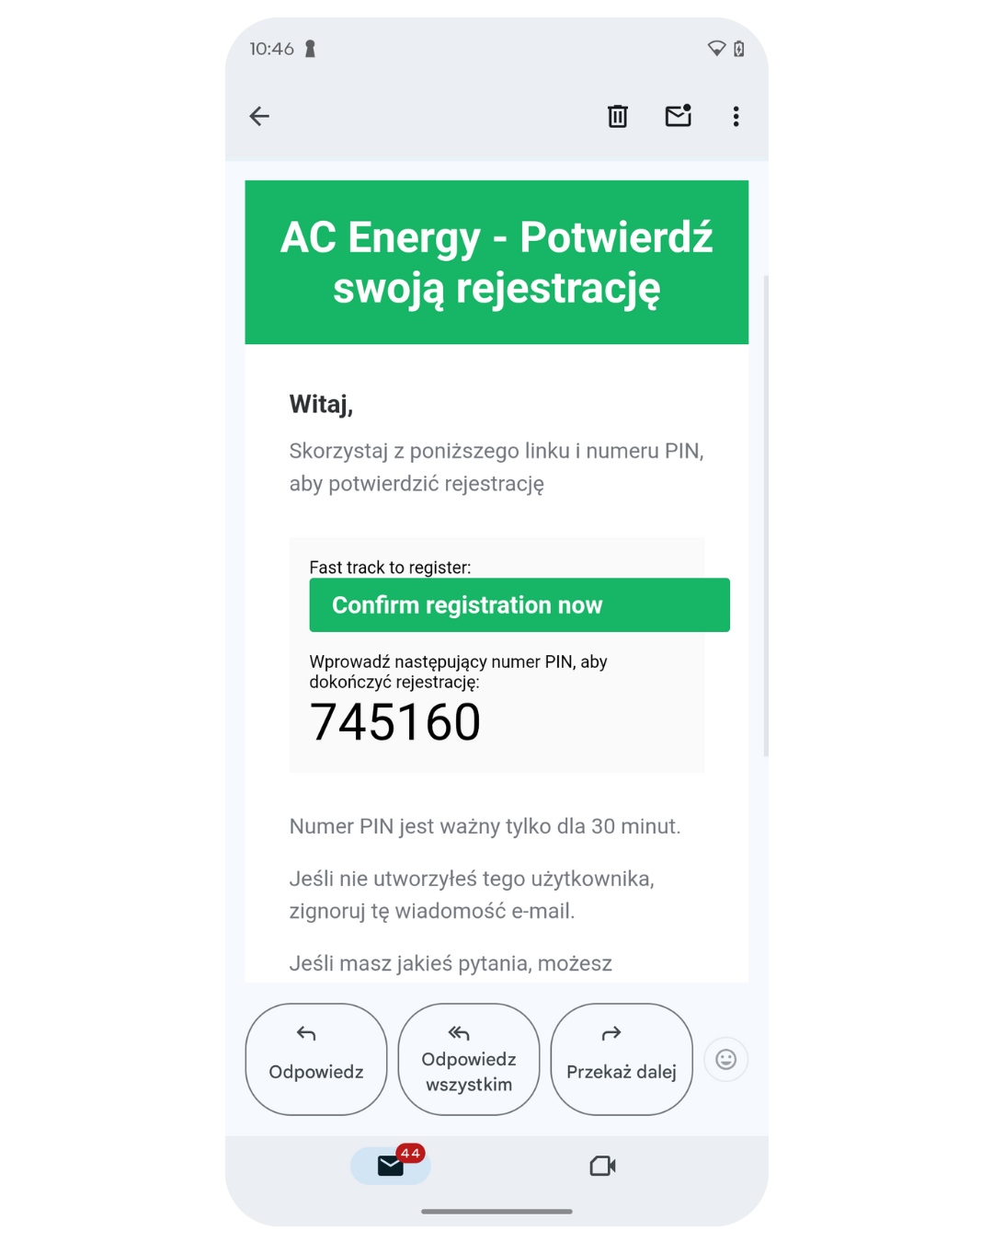
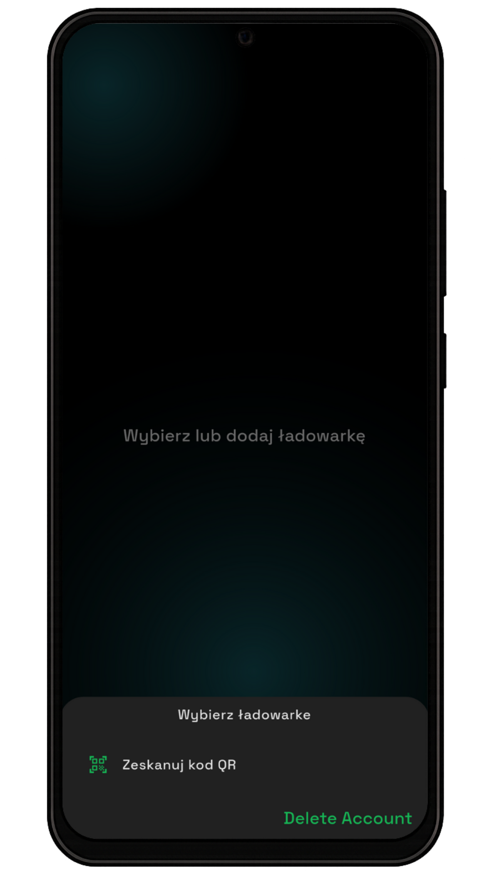
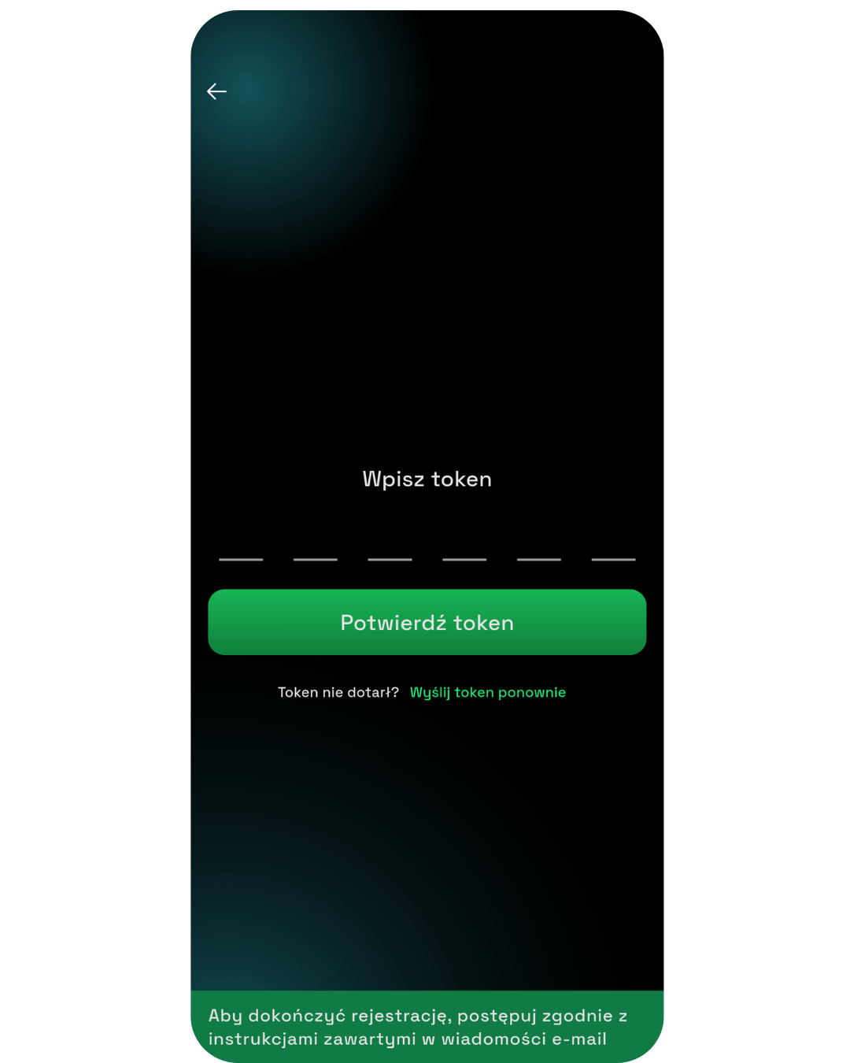
1.1 Creating an Account and Logging In
STEP 1
STEP 2
STEP 3
To create an account, press Sign Up.
Enter your email, phone number, and password, then press Sign Up
In the email, you will find a verification code for your account, or you can click the green button to automatically fill in the token in the app
STEP 4
STEP 5
STEP 6
If you didn't use the automatic code entry, please enter it manually
Login to your account
View after the first login

Slide 4
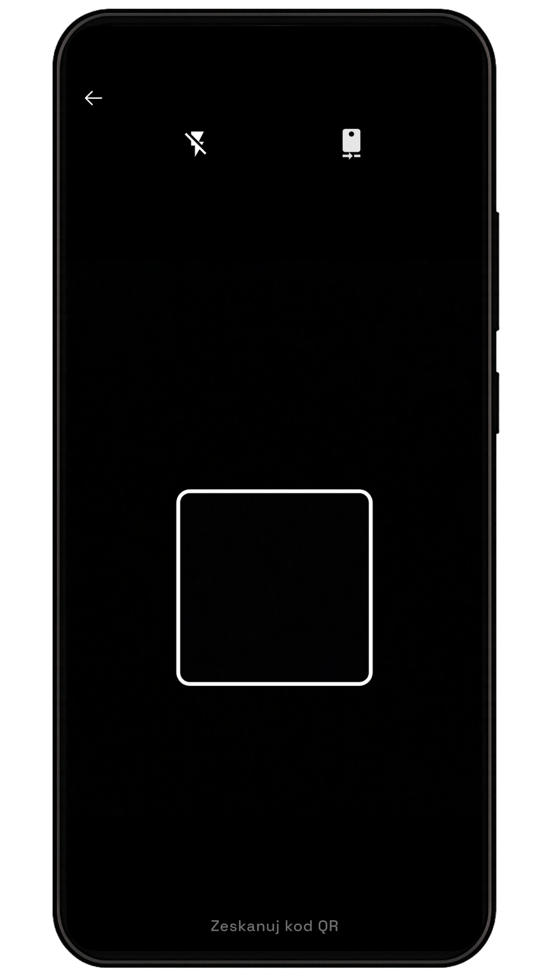
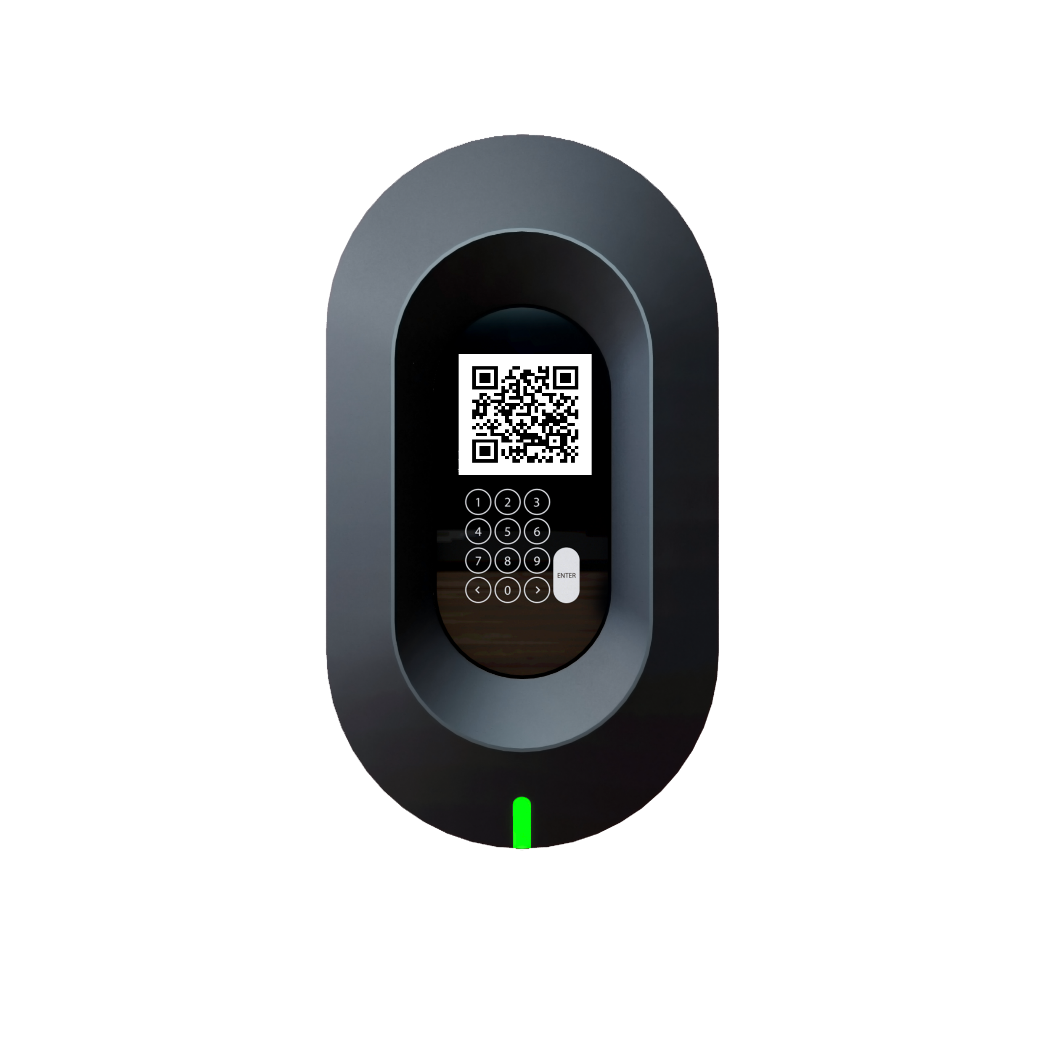
1.2 Adding a charger
STEP 1
STEP 2
After the first login, you need to add a charger. To do this, press Scan QR Code
The next step is to scan the QR code from the charger.
To do this, place the code from the charger inside the white square on your phone screen
After successfully adding the charger, you will be redirected to the main panel.
The view may differ if the charger is connected to a car

Slide 5
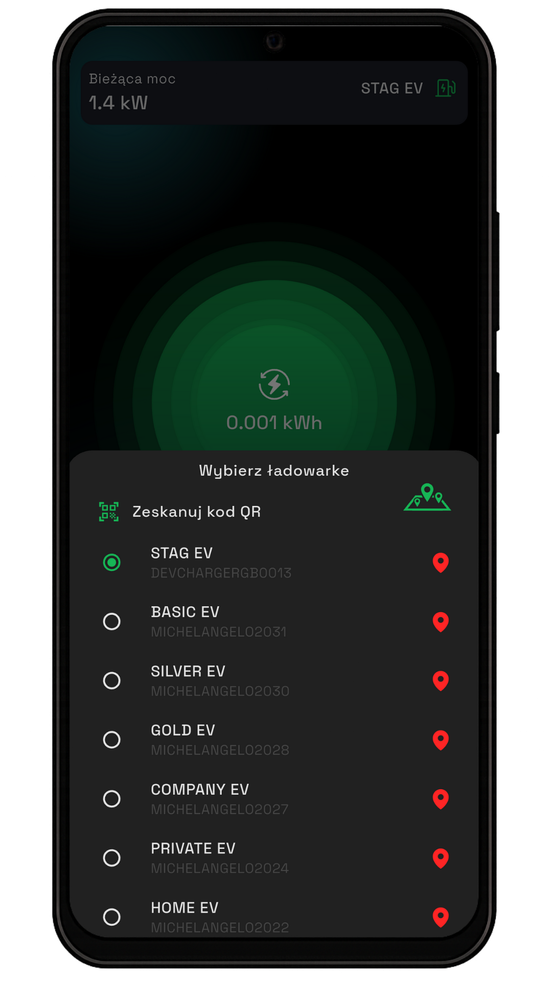
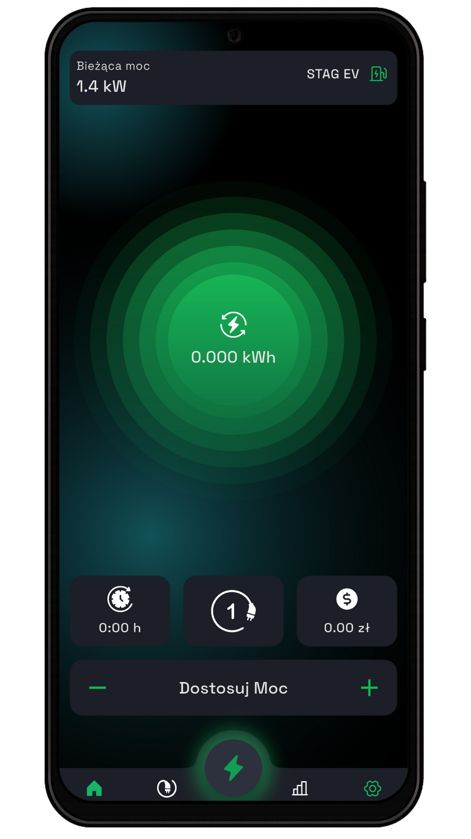
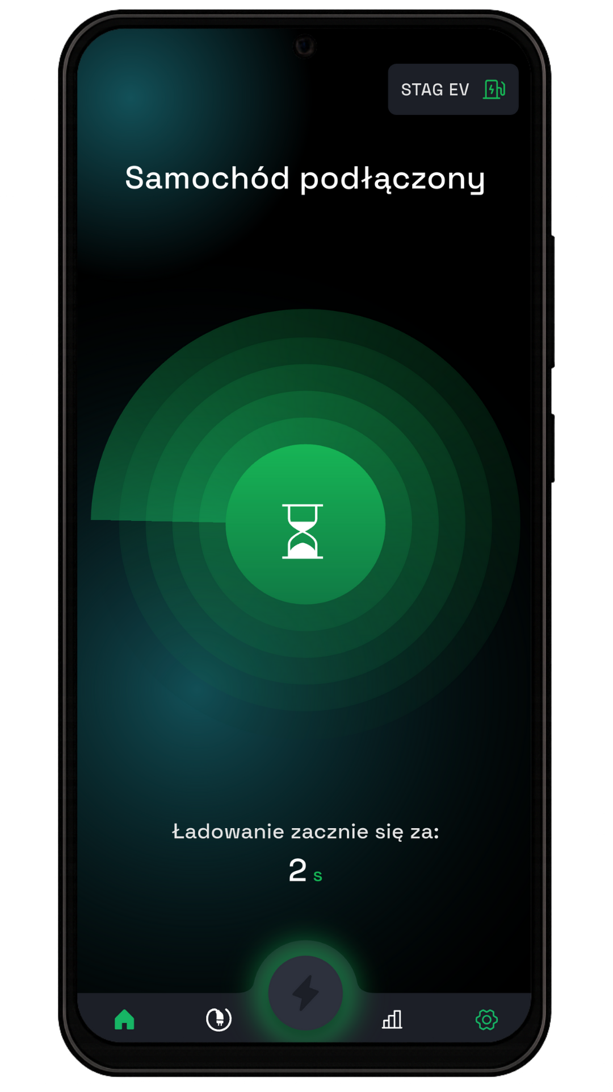
1.3 Adding Additional Chargers
KROK 1
KROK 2
To add another charger, click on the name of the charger.
A list of chargers added to your account will slide out.
To add another one, tap 'Scan QR Code' and follow the same steps as before
2. Main view
Below are three different views of the main panel. Each screen contains clear messages and icons that inform the user about the current status
View when the charging plug is disconnected from the car
View when the charging plug is connected to the vehicle during charging
View when the charging plug is connected to the vehicle with scheduled charging

Slide 6
2.1 Description of the Main View
10
9
8
5
6
7
12
1
2
11
3
4
Display of Charging Modes
Charging Statistics
Settings
Charging Time
Charging Mode Selection
Current Charging Cost
Energy Consumption Indicator During Charging
Name of the Active Charger (tap to select)
Current Charging Power
Start/Pause Charging Button
Charging Power Switch

Slide 7
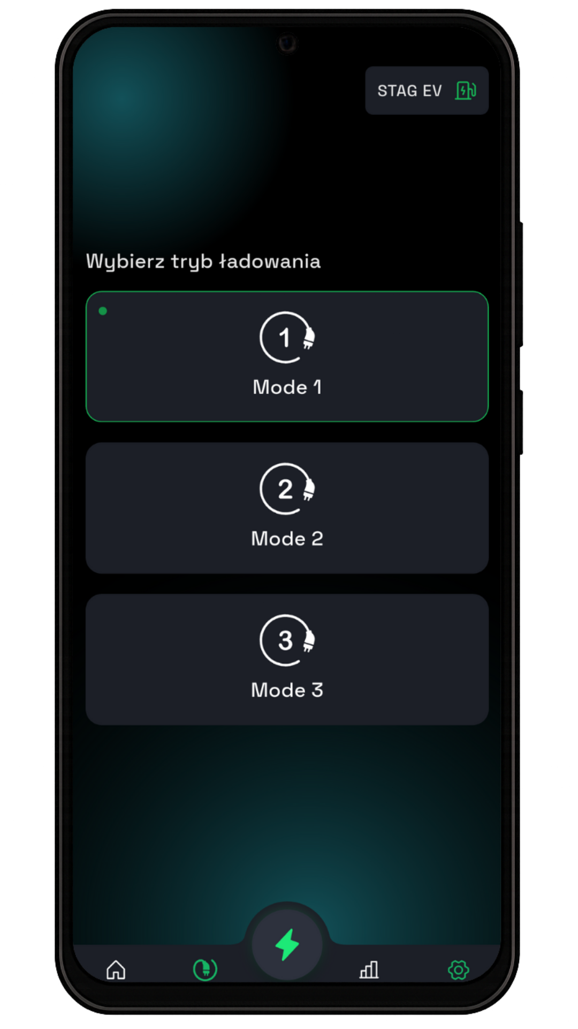
2.2 Charging modes
To change chraging mode press here
You can choose one of the three work modes here
To define these modes, go to the work mode settings

Slide 8
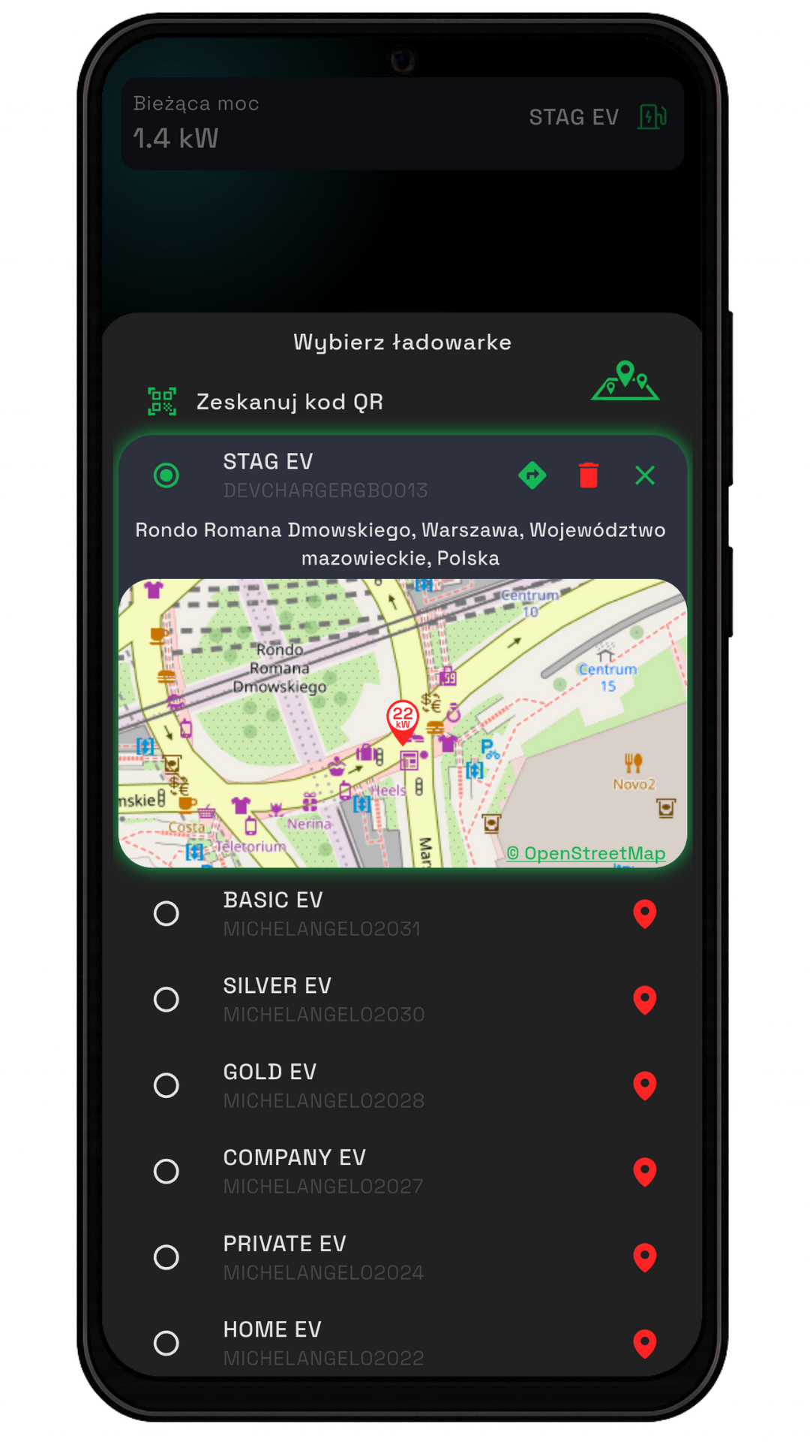
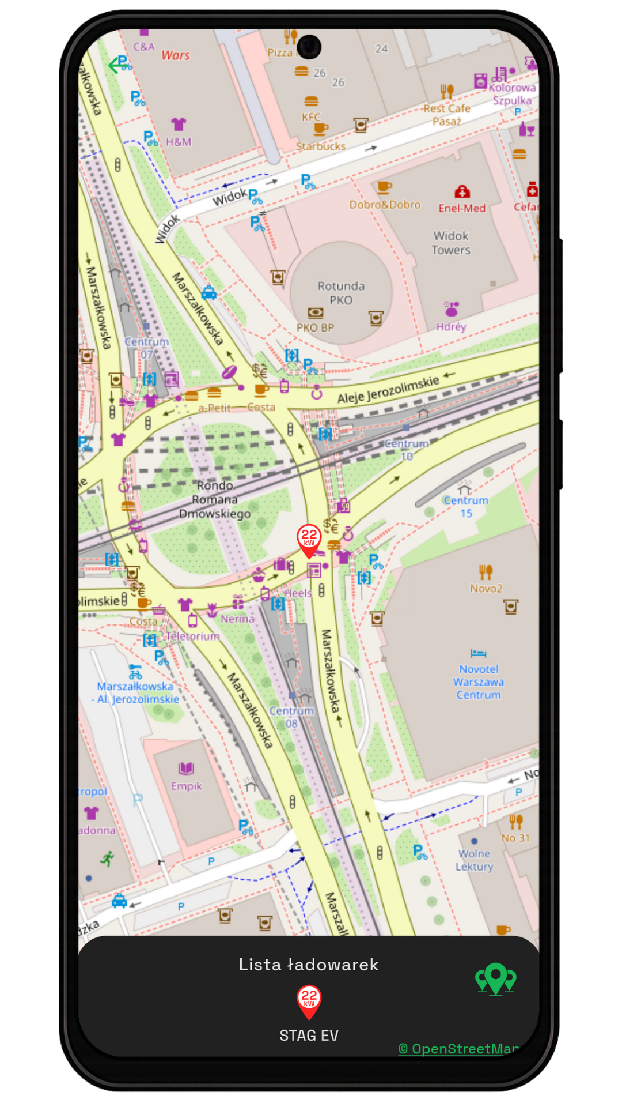
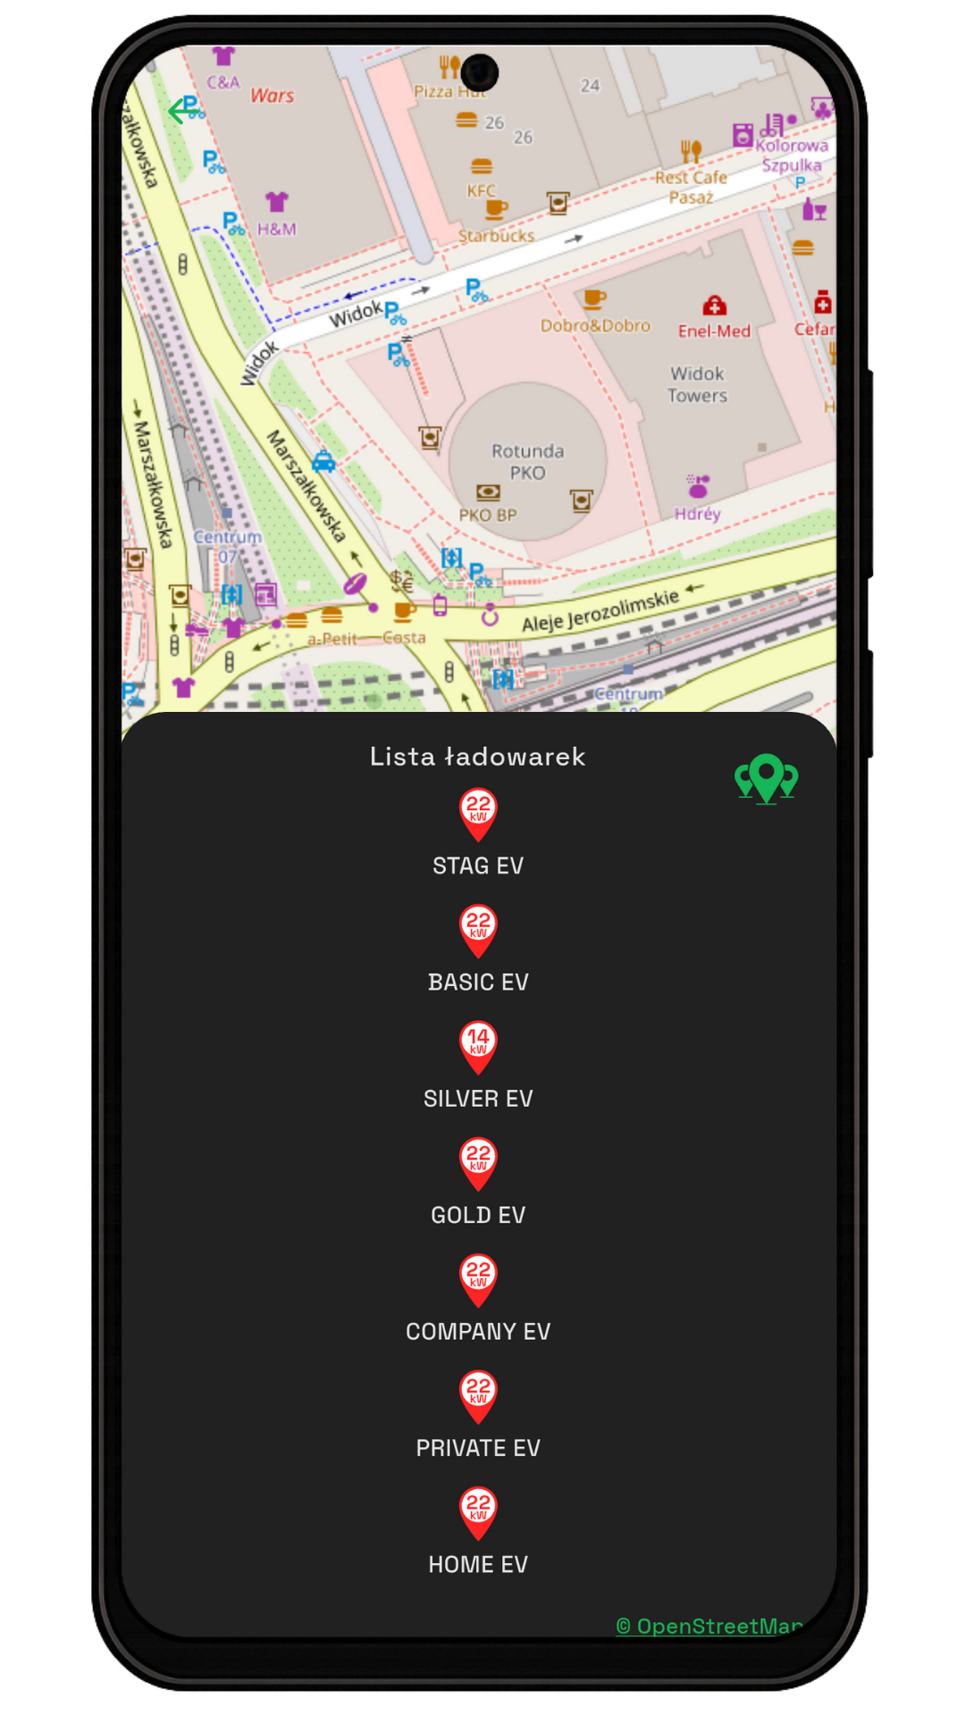
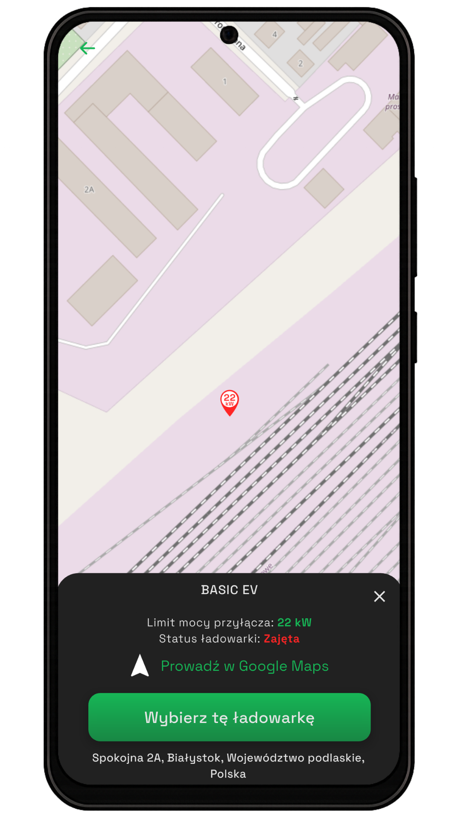
2.3 Charger location
The STAGEV app includes a map of added chargers.
To access it, tap the charger selection window
A list of all chargers assigned to your account will slide out, along with their locations.
From here, you can set a route by tapping the green arrow or enlarge the map by tapping on it
Map view with a list of all chargers.
This list can be expanded by swiping it upward
Here you can select a charger; after tapping it, the location of the selected charger will be displayed
After selecting a charger, you can see whether it is currently in use, check its connection power limit, and set a route using Google Maps

Slide 9
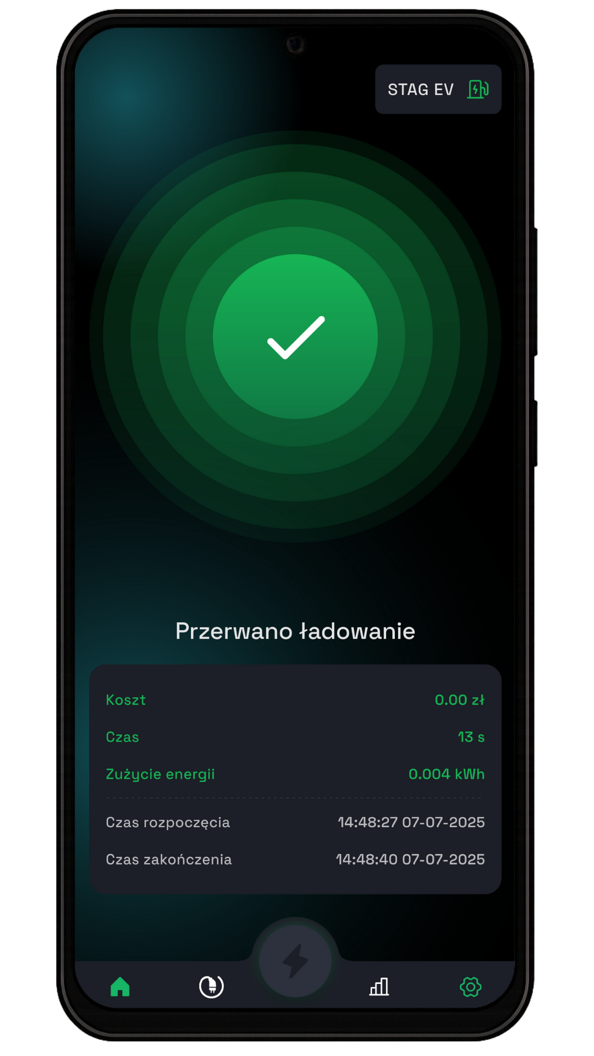

2.4 Pausing and Resuming Charging
You can stop charging by pressing the designated button
Charging can be stopped by pressing the indicated button
2.5 Ending the Charging Session
View after automatic charging completion with a summary of its parameters.

Slide 10
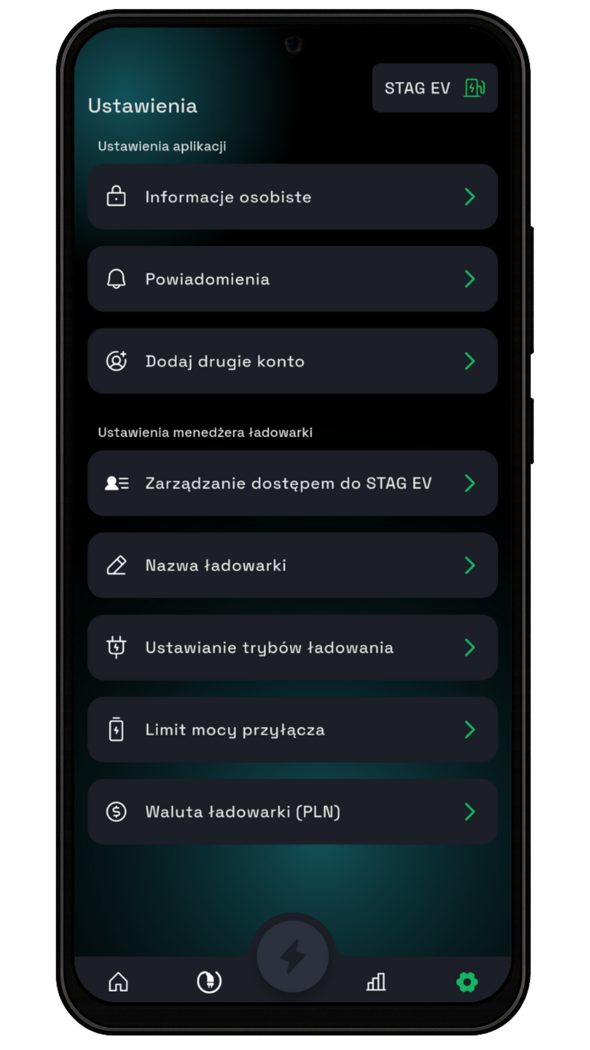
3. Settings
A brief description of the settings from top to bottom
Personal Information – access user data like email
Notifications – choose which push notifications to receive
Add Second Account – add a business or private account
Manage Access to STAGEV – control who can access the charger
Charger Name – change or set charger name
Charging Modes – choose different charging modes
Connection Power Limit – set the max power the charger can draw
Charger Currency – choose the currency for charging costs

Slide 11
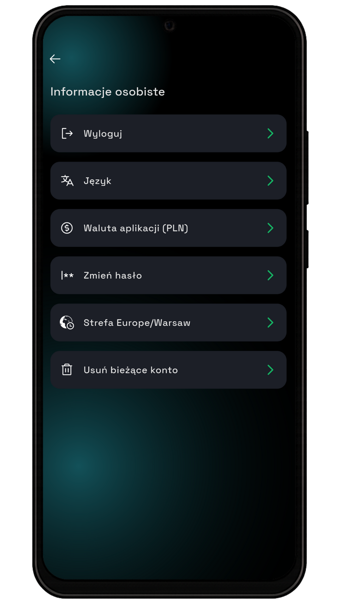
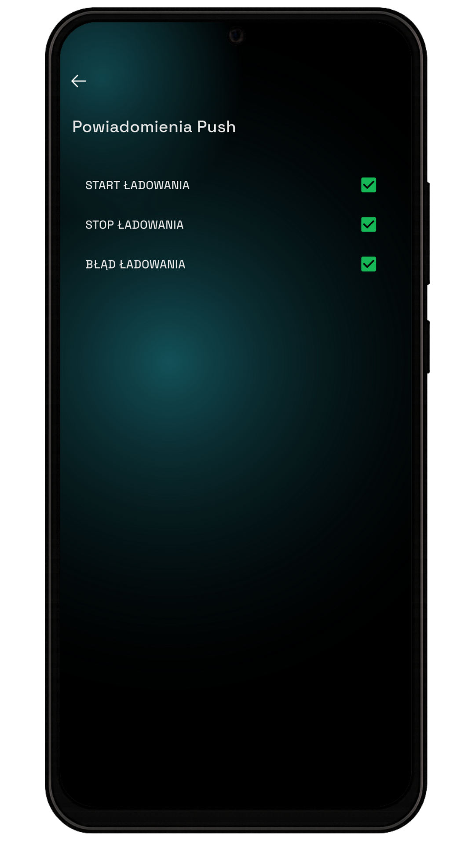
3.1 Personal Info & Notifications
Log Out – log out of the account
Language – change app interface language
App Currency – choose currency for prices
Change Password – update account password
Time Zone – set time zone
Delete Account – permanently delete current account
3.2 Notifications
The screen displays three buttons related to push notifications. Here are their descriptions:
Start Charging – push notification when charging starts
Stop Charging – push notification when charging ends
Charging Error – push notification if an error occurs

Slide 12
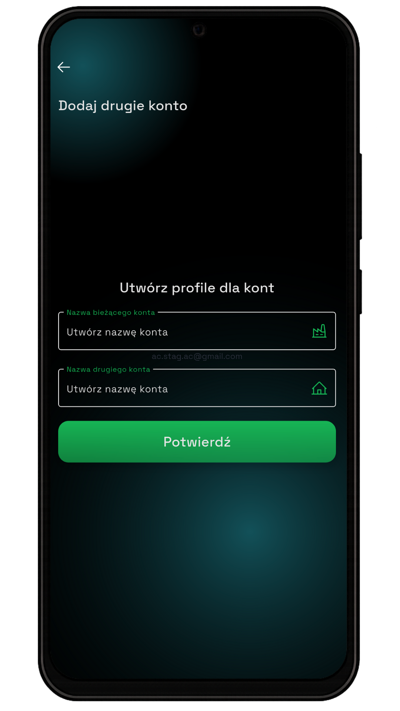
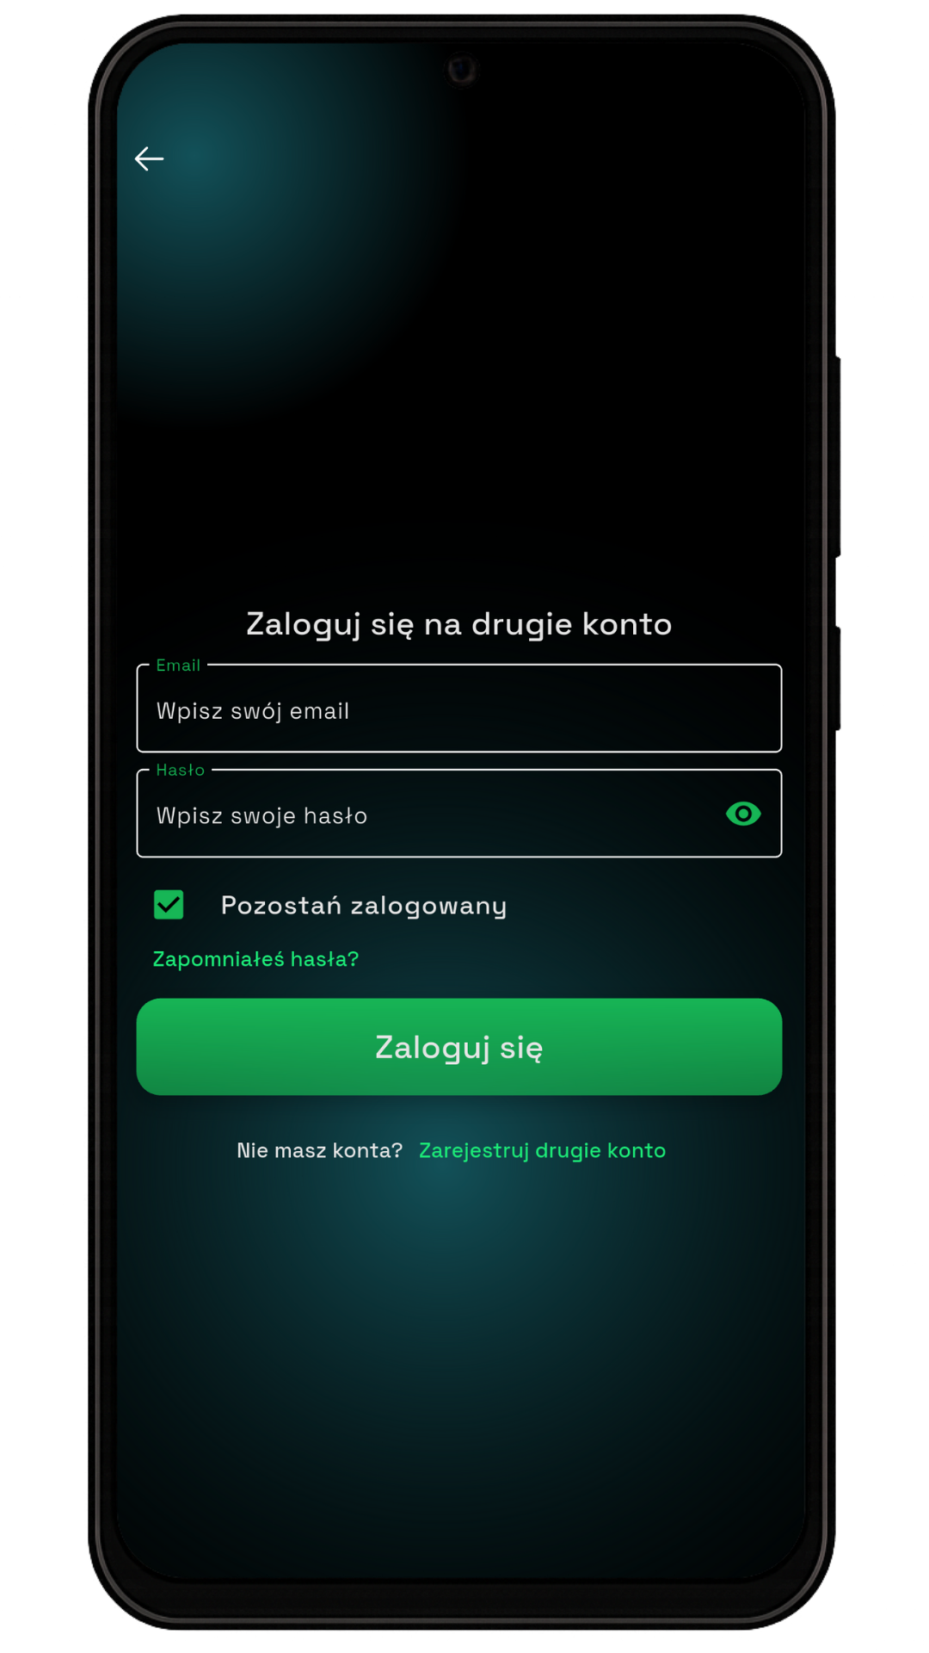
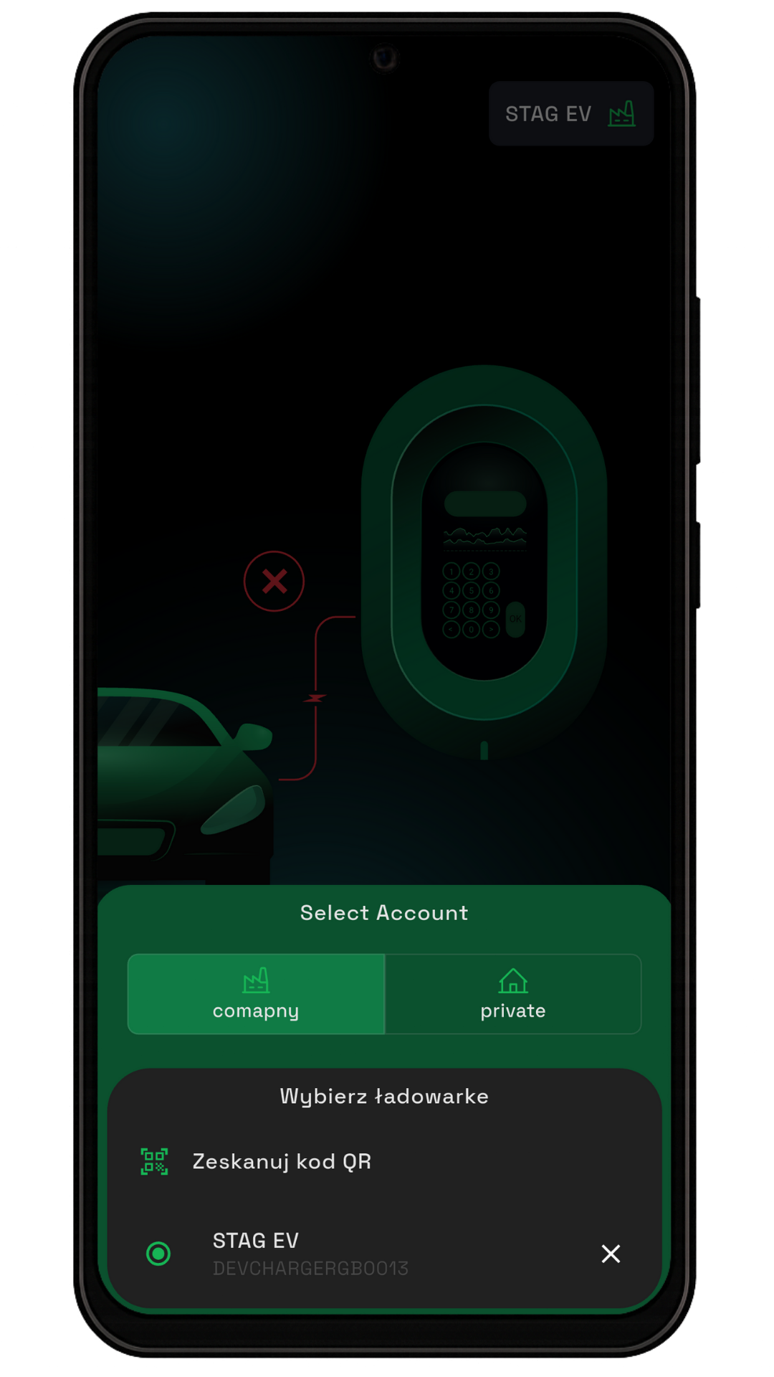
3.3 Adding a Second Account
The app allows you to add a second business or private account.
To add a second account, enter the names for both accounts and click "Confirm."
To continue, you must log in to the second account.
If you don't have a second account, you need to register one by clicking "Register second account."
The registration process is the same as for the first account.
After successful registration, you will be able to switch between business and private accounts when selecting a charger.

Slide 13
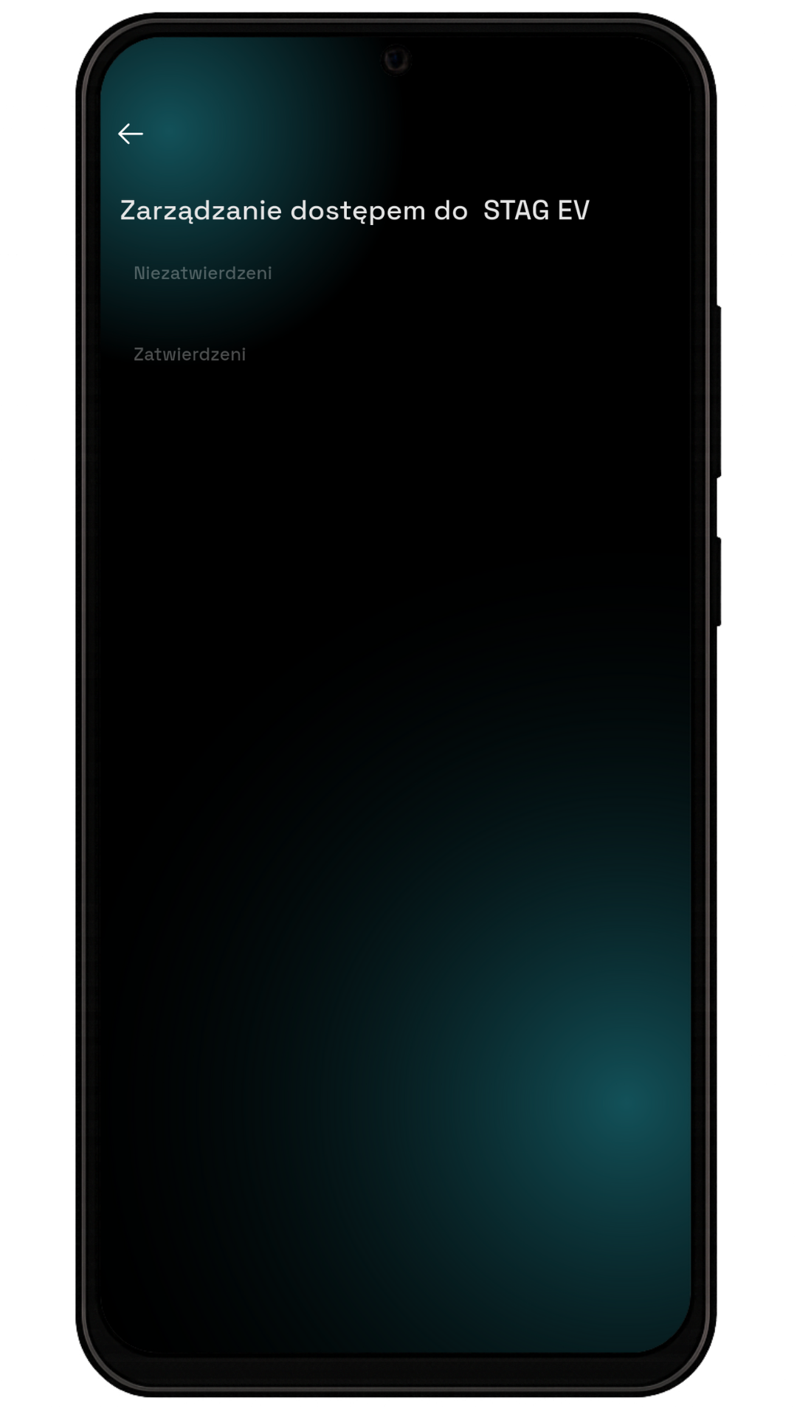
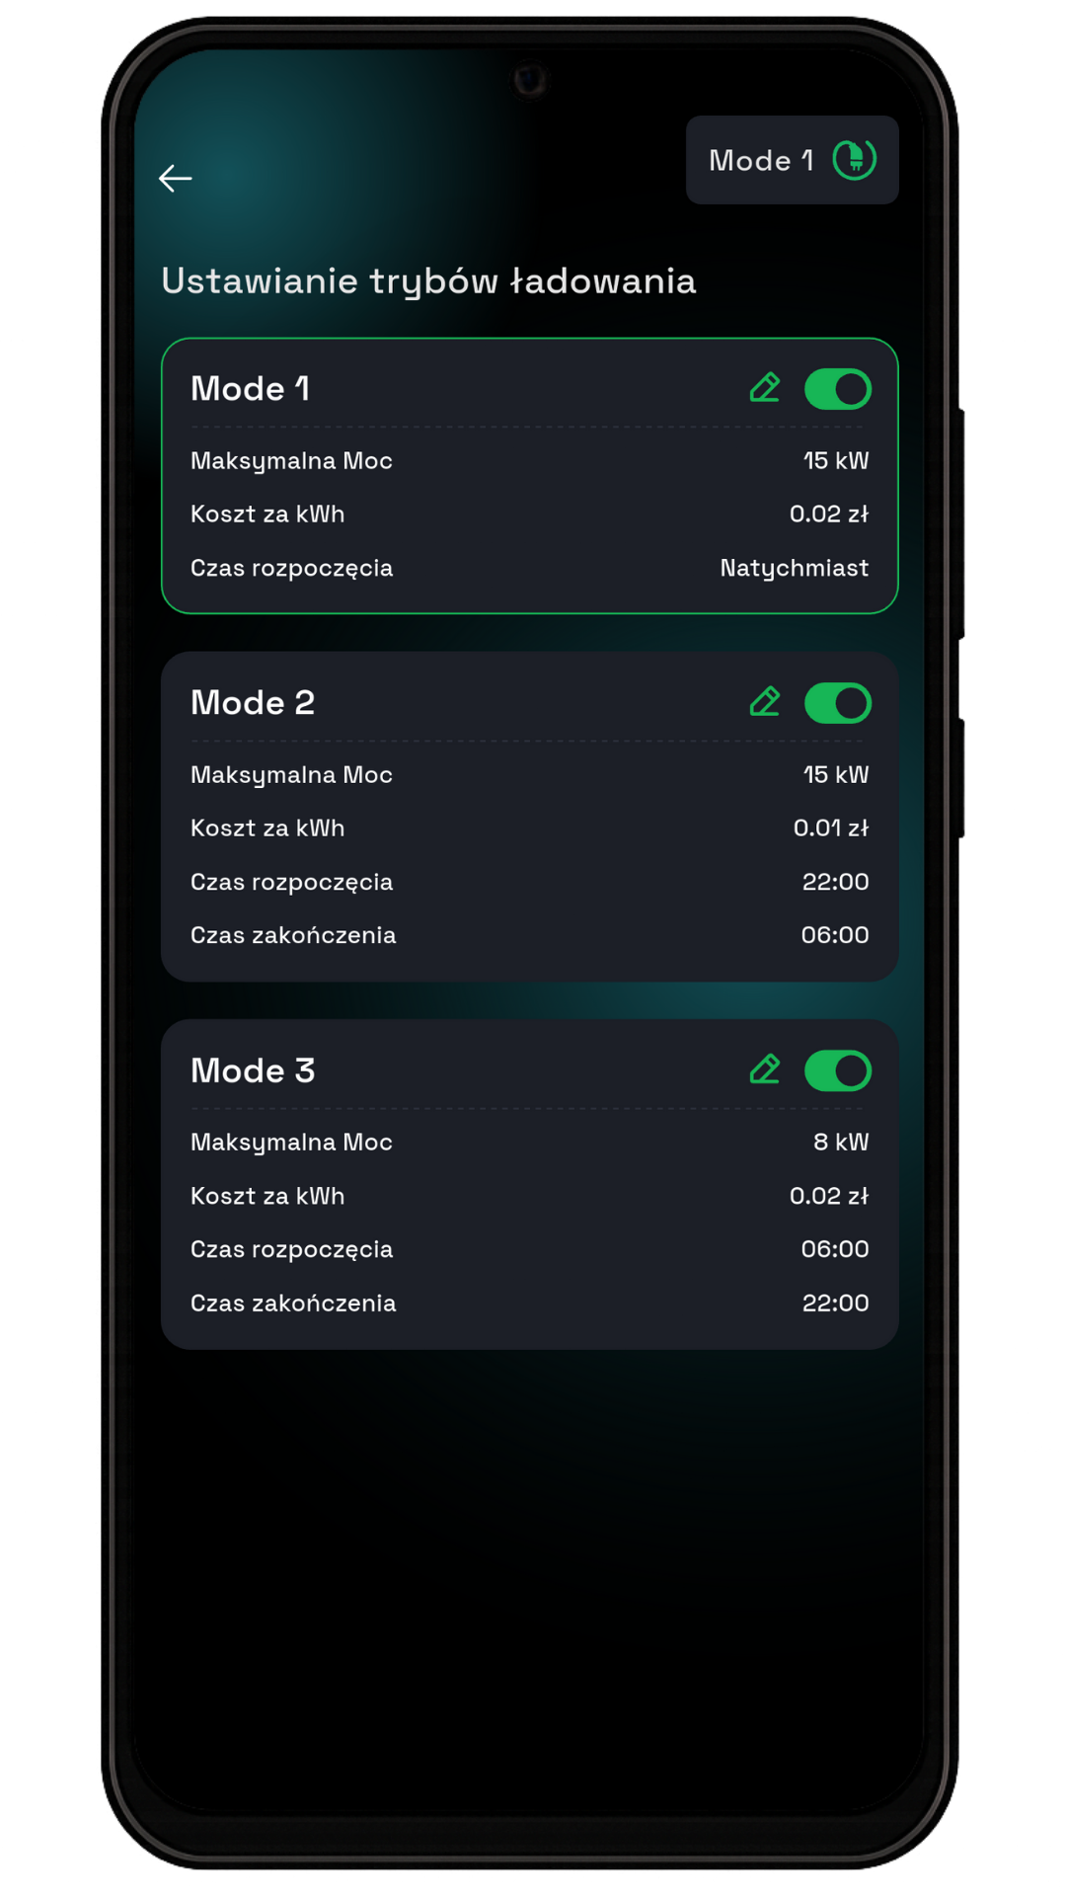
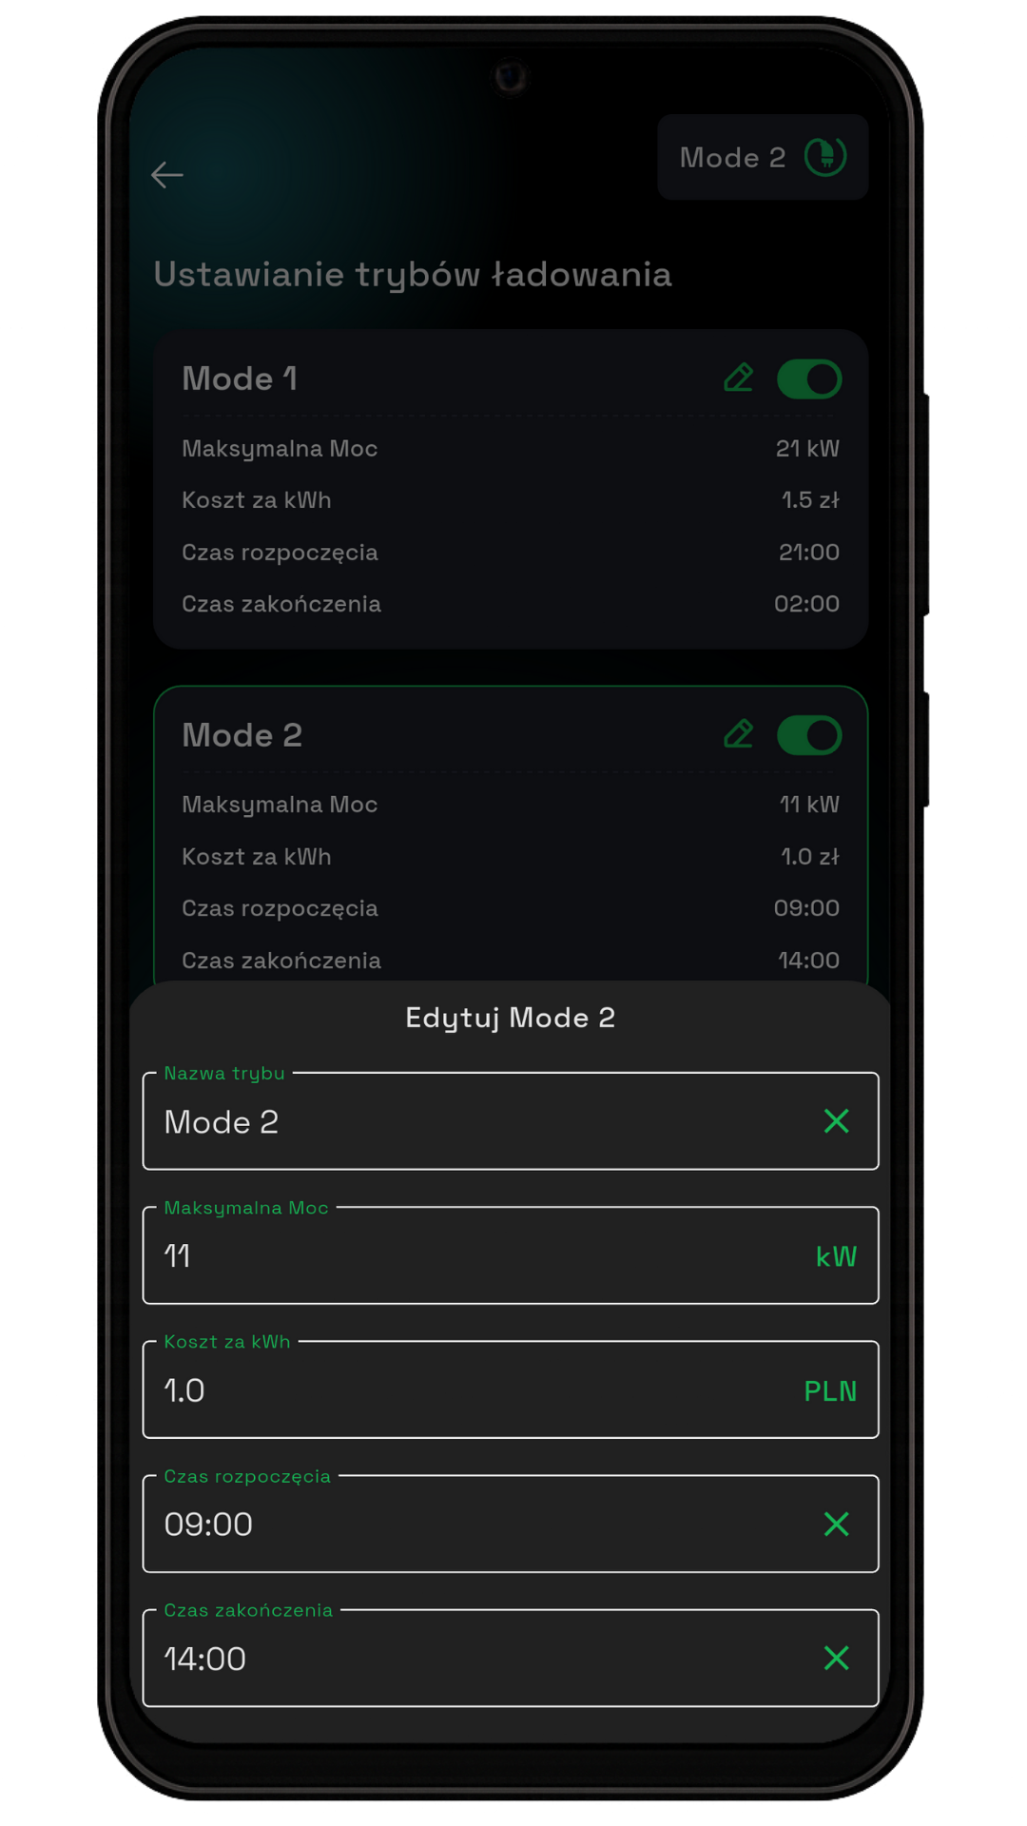
3.4 Managing Access to STAGEV
The charger owner can decide who has access to the app.
At this point, accounts of other charger users will be displayed.
To grant access to another user, their account will appear in the "Unapproved" section.
Then, you need to click on their account and grant access.
3.5 Setting Charging Modes
Three different setting modes can be defined, which the user can configure independently.
After expanding the window, you can change: the name, maximum power, cost per kWh, and set a charging time limit.

Slide 14
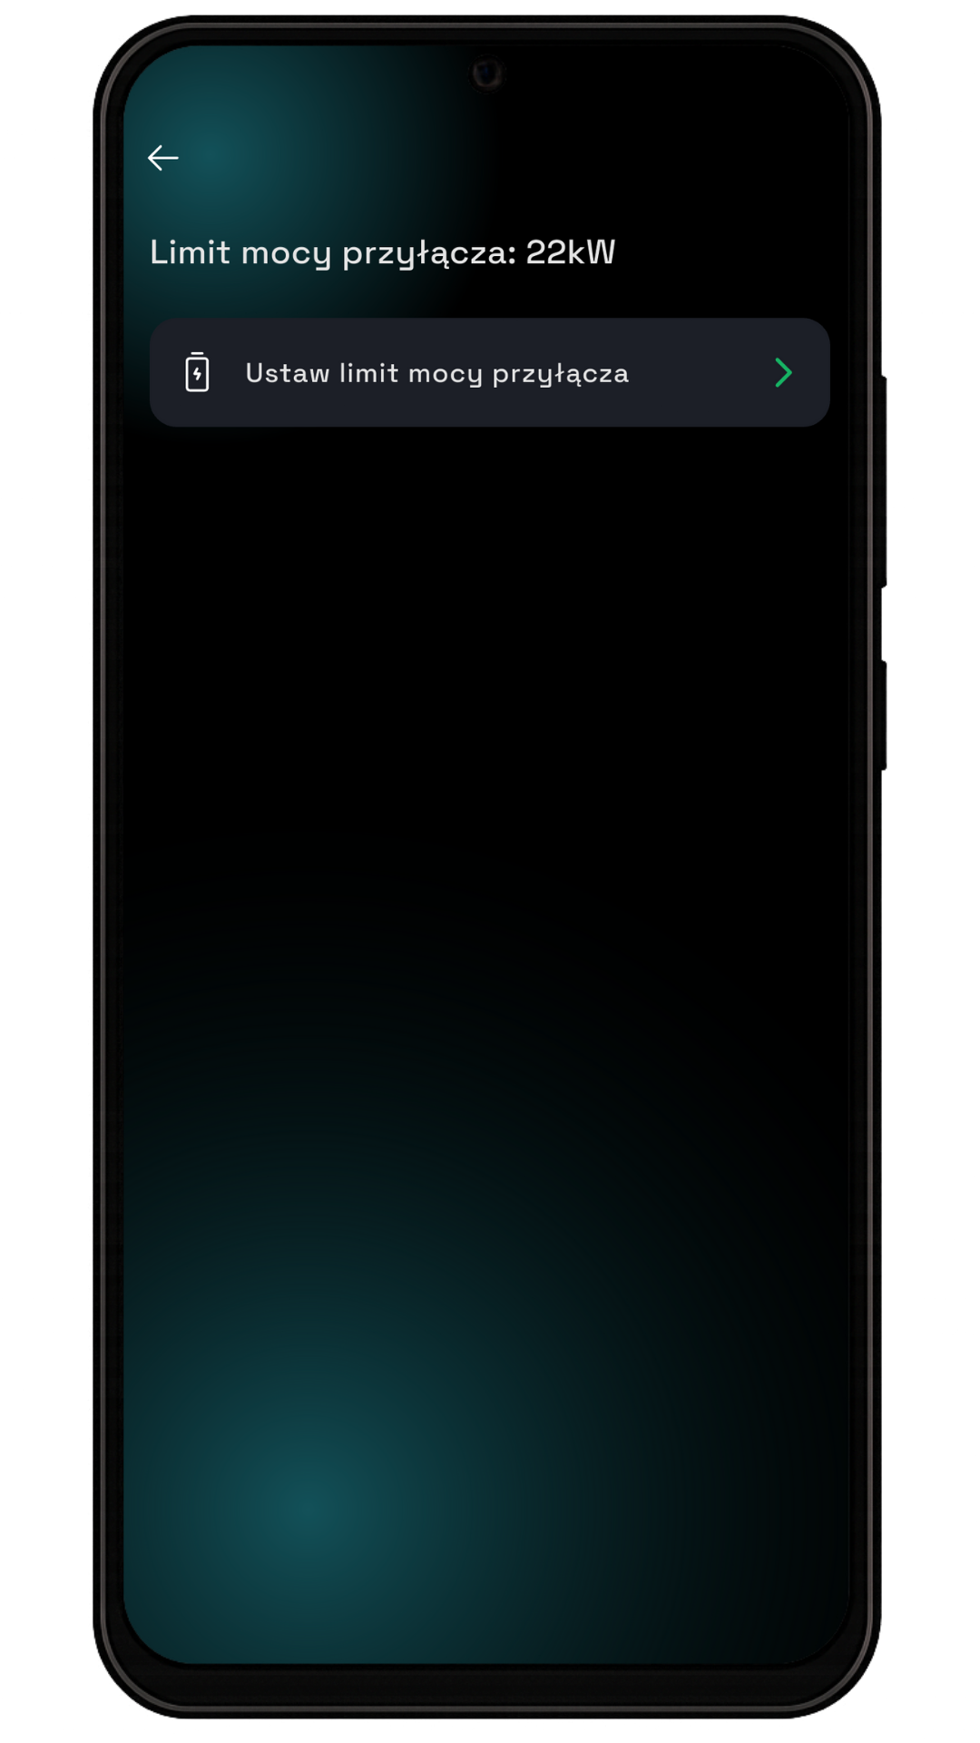
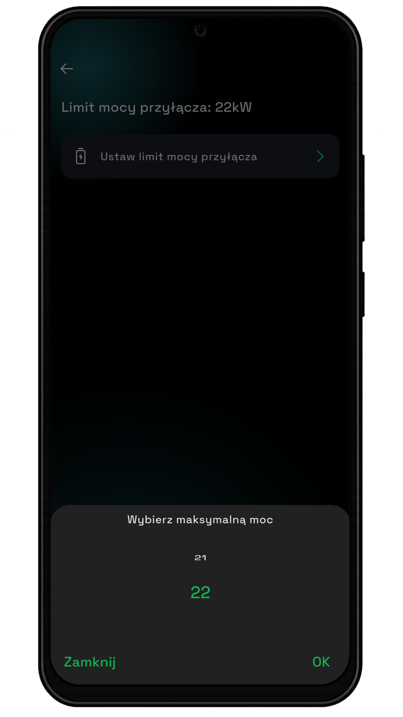
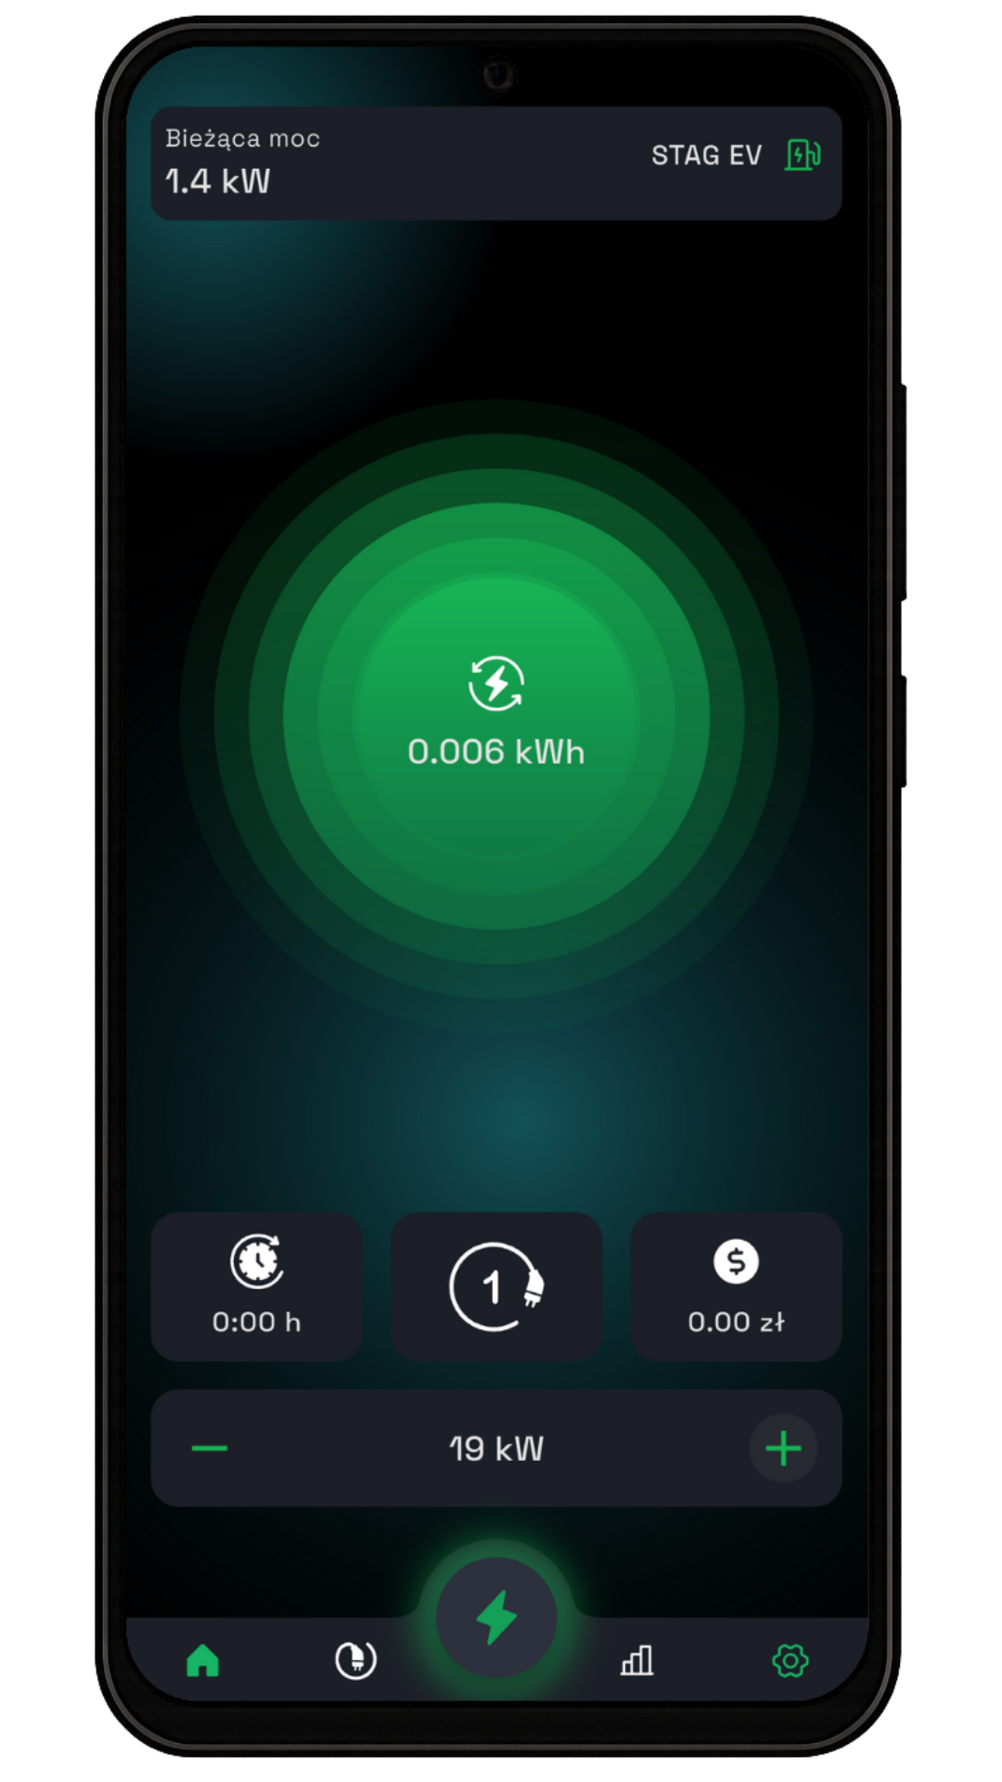
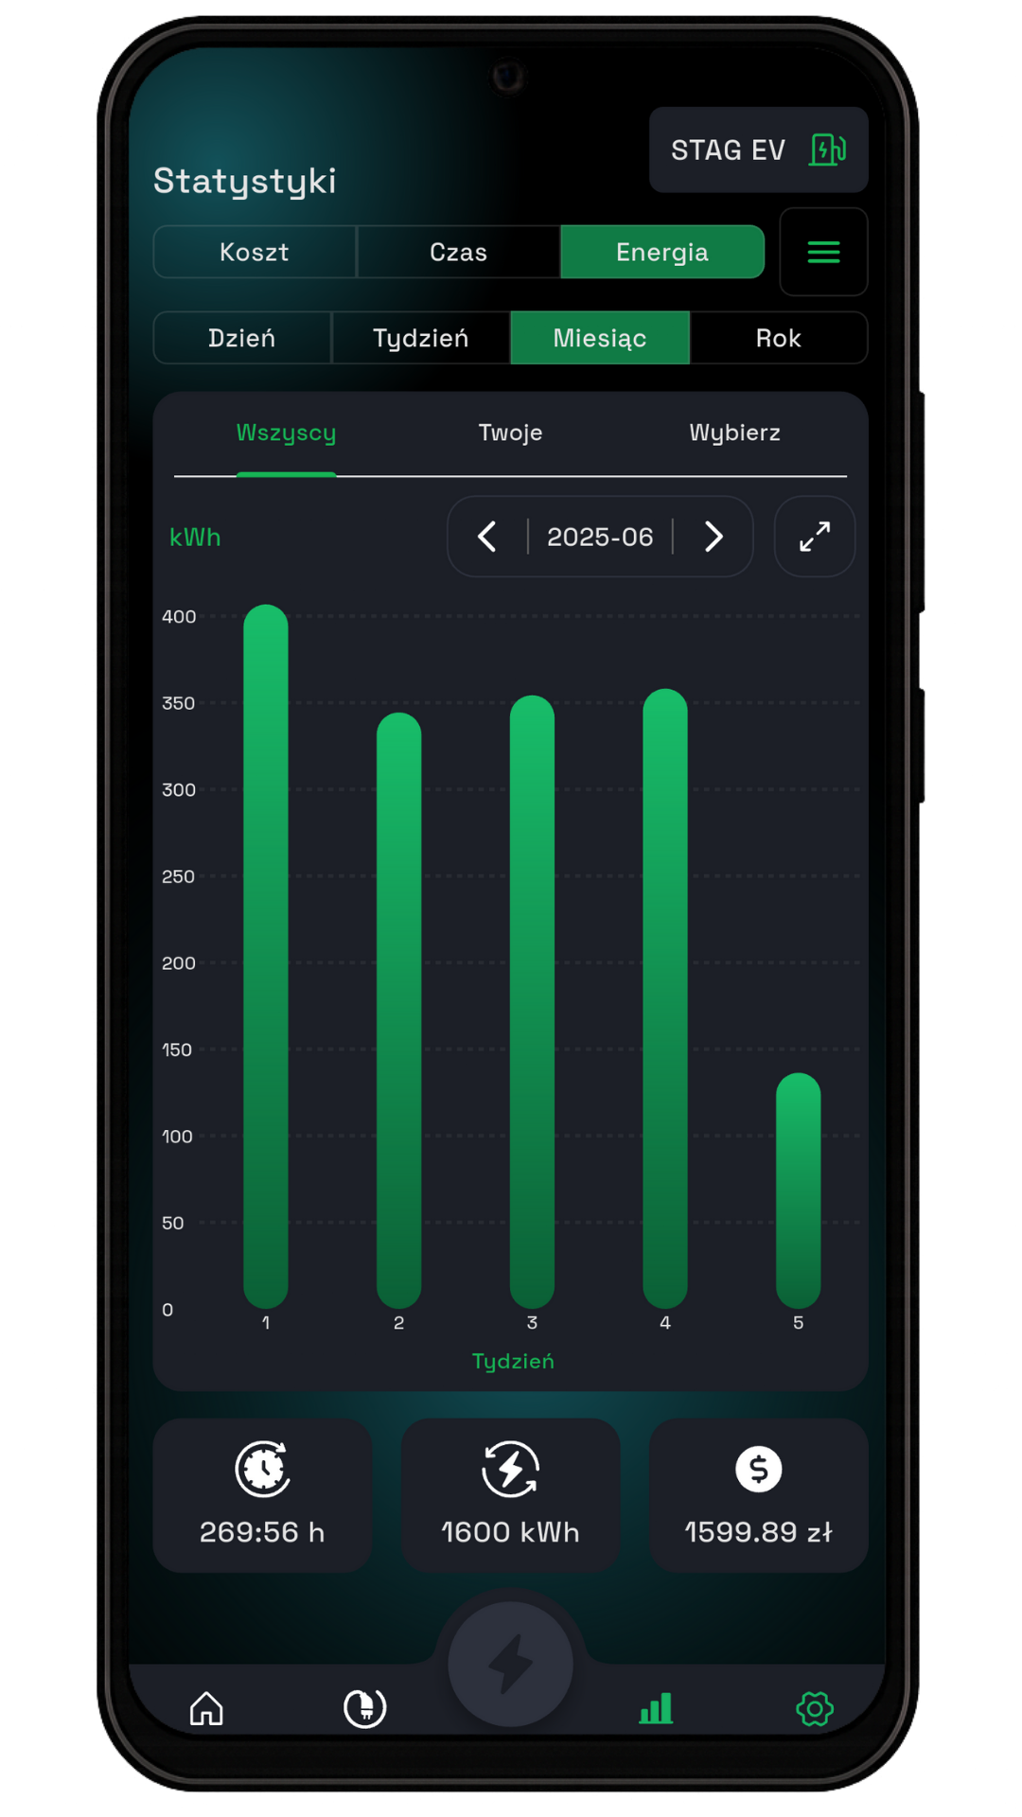
3.6 Connection Power Limit
Setting the maximum connection power limit. The charger or chargers connected to the network will not exceed this value.
elect the indicated option,
then set the power limit by scrolling the value up or down.
4. Statistics
To access the statistics view, tap the highlighted icon.
The charts show the cost, energy consumption, and charging time for the selected period.

Slide 15
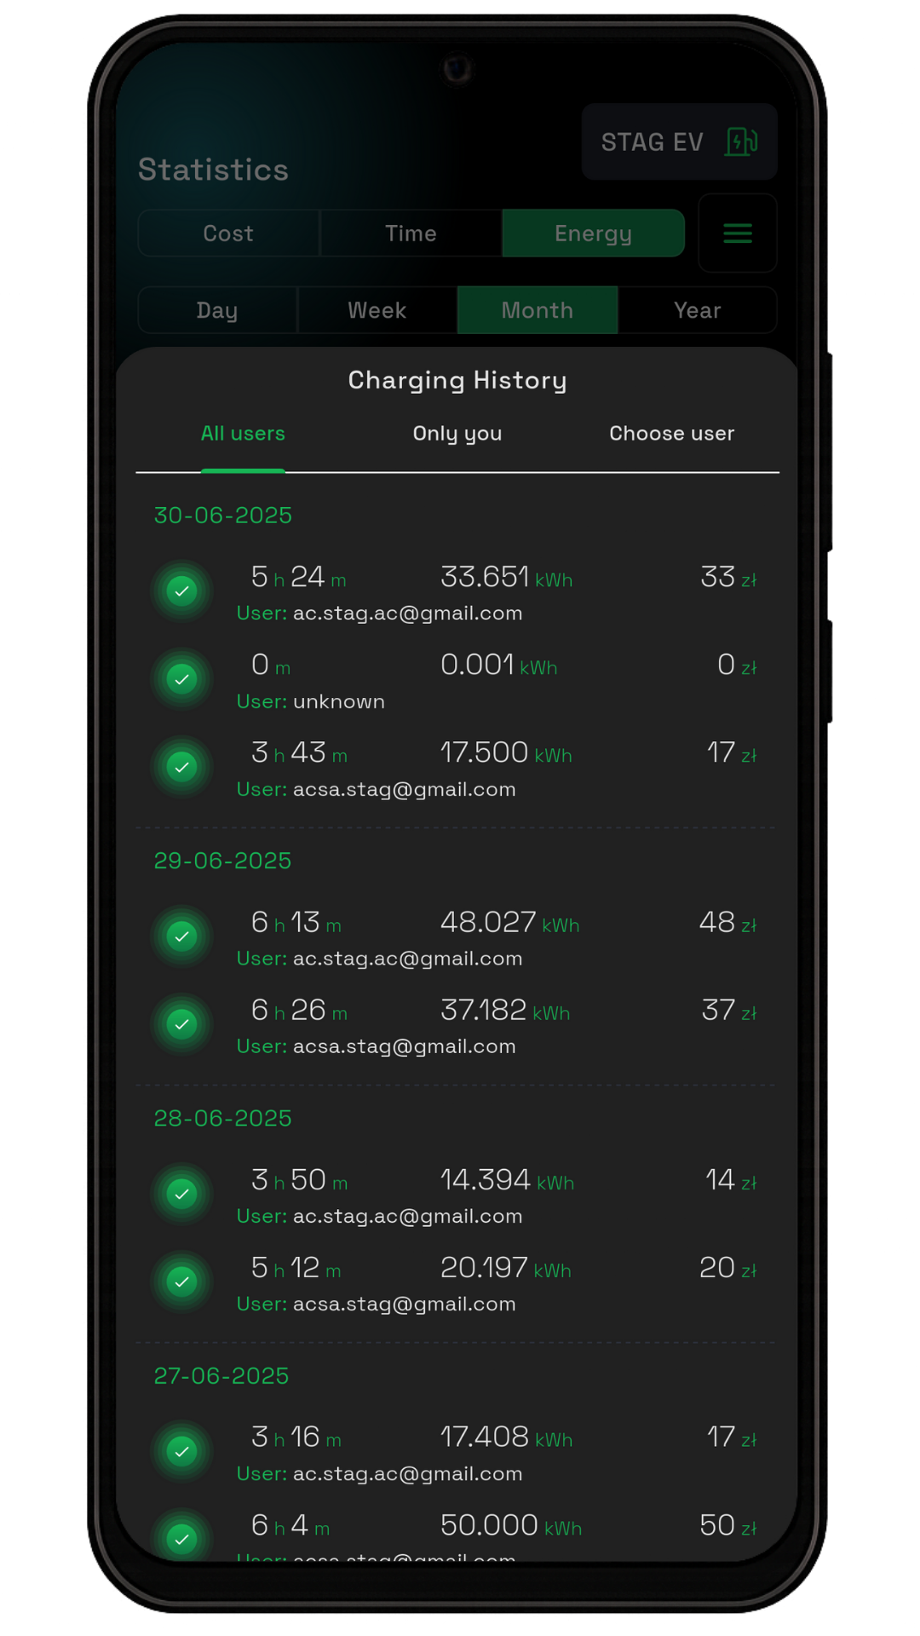
4.1 Charging History
Here, the cost, energy usage, time, and charger user are listed.
To view the charging history, tap the highlighted icon.
A list of the charging history will appear, divided by days and including each individual charging session.

